Slide 1
Business Process – Accounts Payable (Small business)

Slide 2
Stakeholder Wheel

Slide 3
Accounts Payable Stakeholder Wheel
Finance Manager
Department Analyst
Department Manager
Stakeholder Wheel

Slide 4
Business Process Model and Notation Diagram

Slide 5
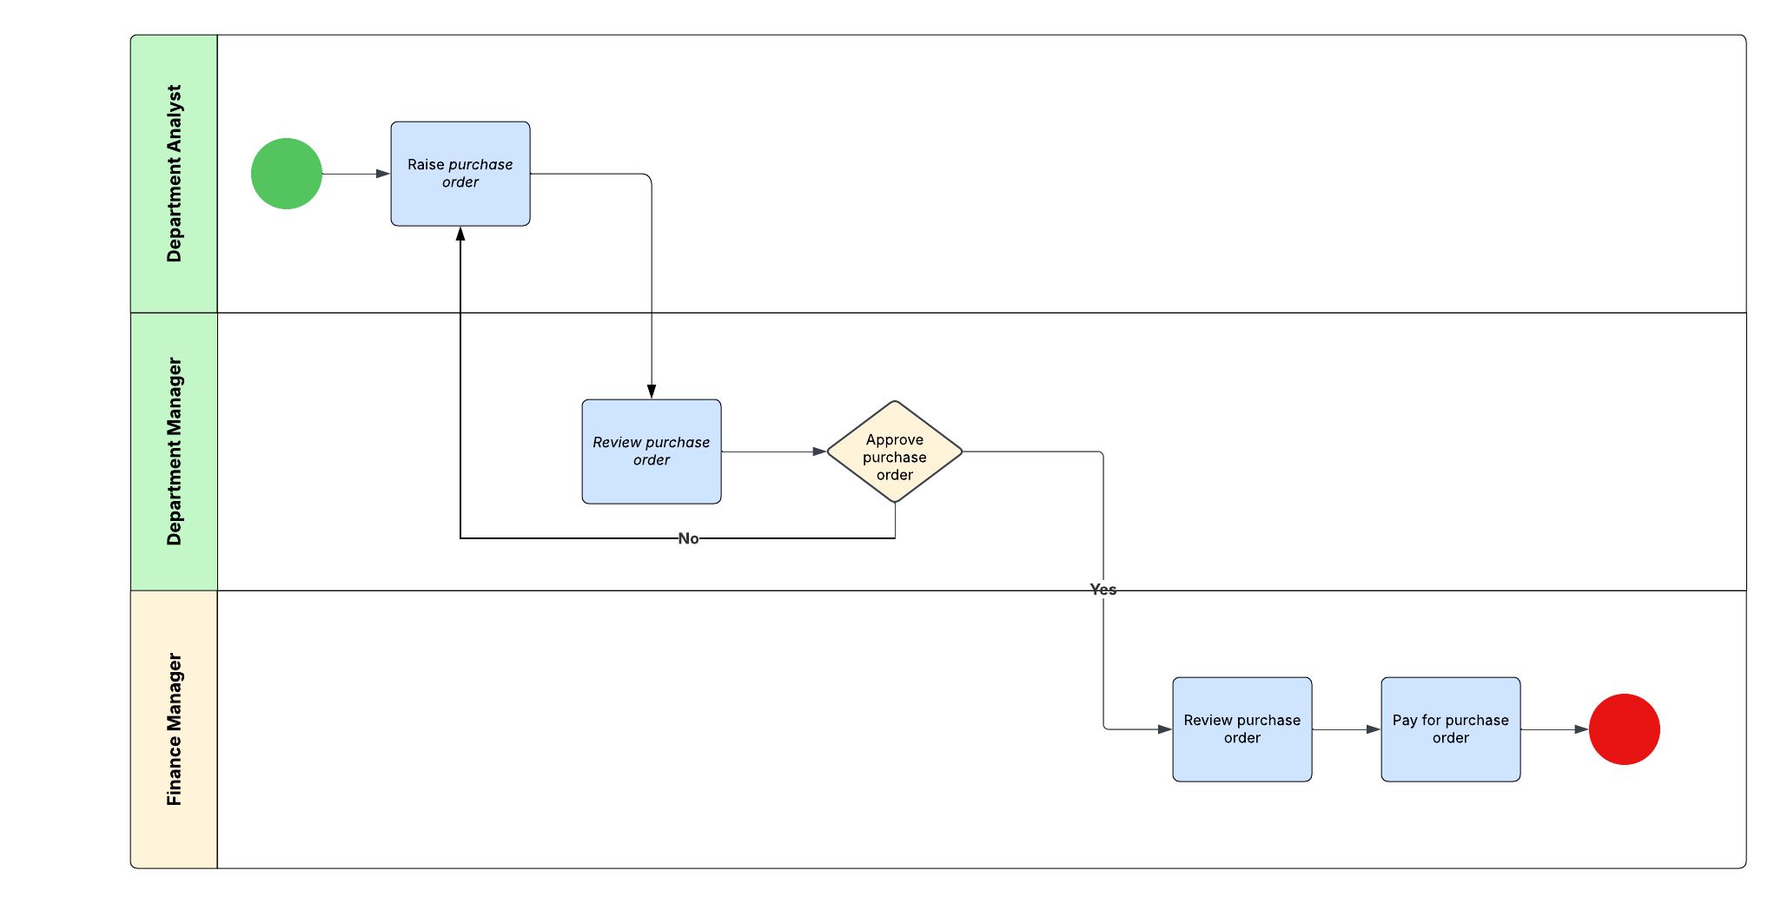
Accounts Payable Business Process Diagram

Slide 6
Project Management & Version Control

Slide 7
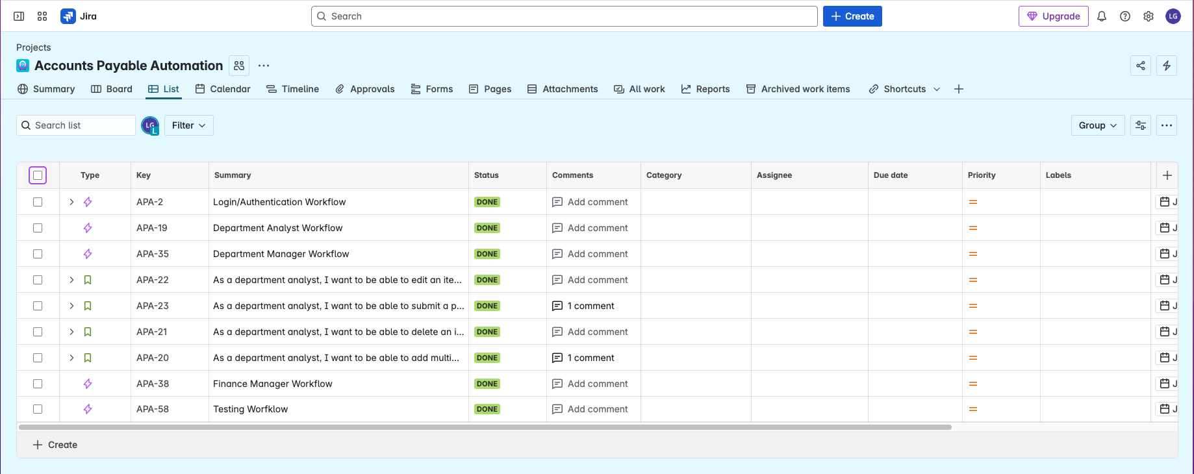
Accounts Payable Project Management – Task list

Slide 8
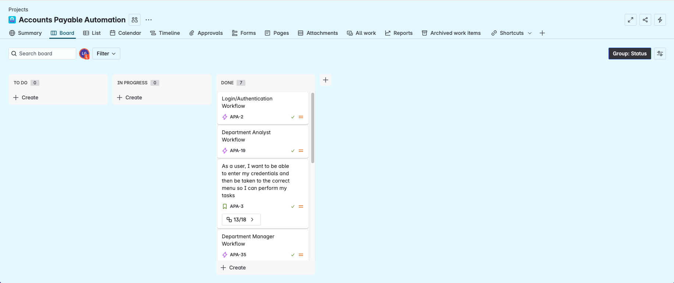
Accounts Payable Project Management – Kanban

Slide 9
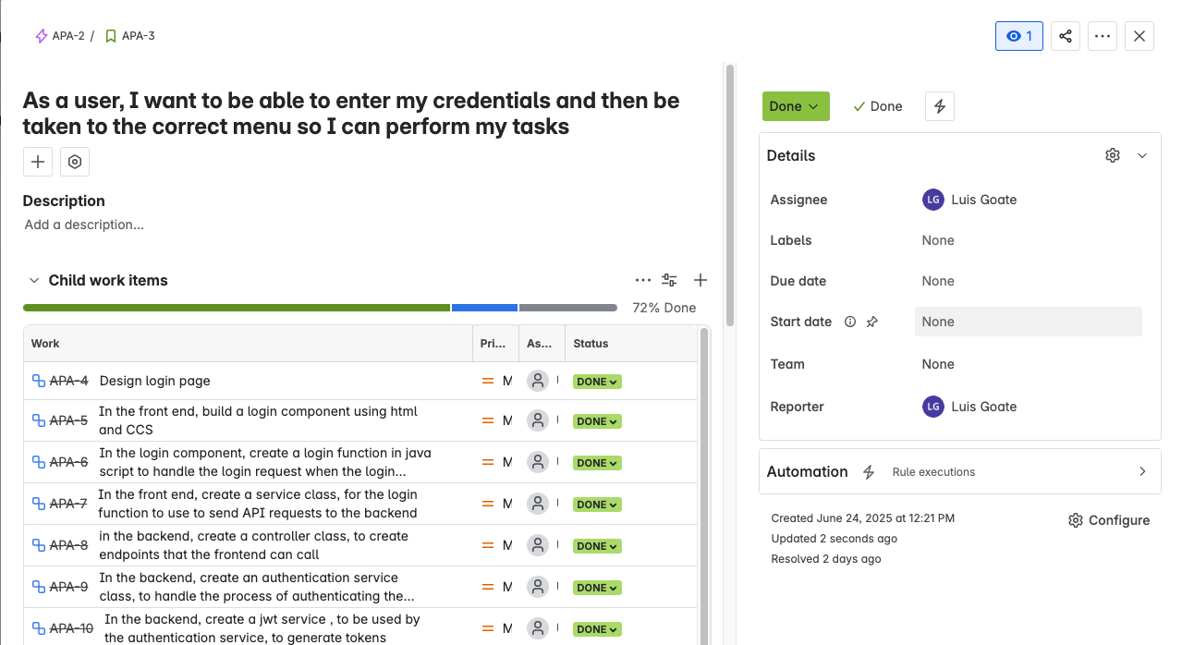
Accounts Payable Project Management – User Story

Slide 10
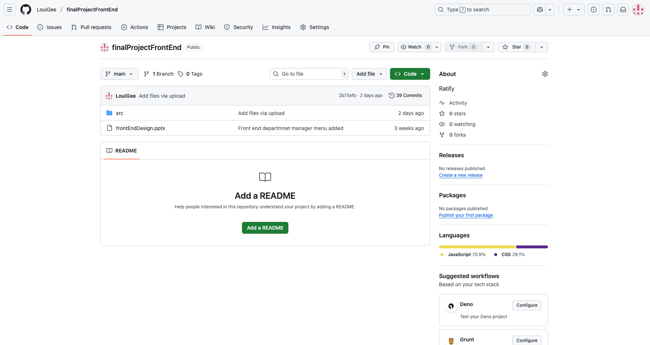
Version Control Frontend
Note: only the src file from the react project has been version controlled ( the entire react project is too large to be version controlled). This file be placed within any react project and the project should run
https://github.com/LouiGee/finalProjectFrontEnd

Slide 11
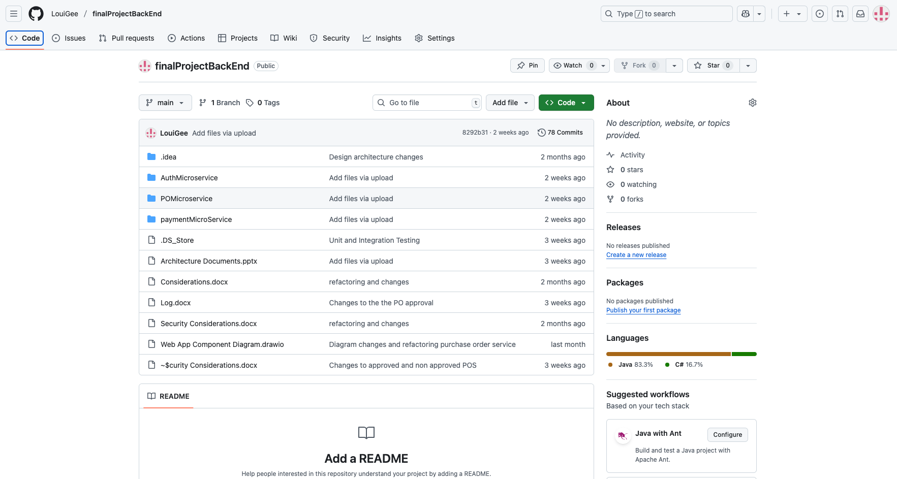
Version Control Backend
https://github.com/LouiGee/finalProjectBackEnd

Slide 12
System Design

Slide 13
Component Diagram

Slide 14
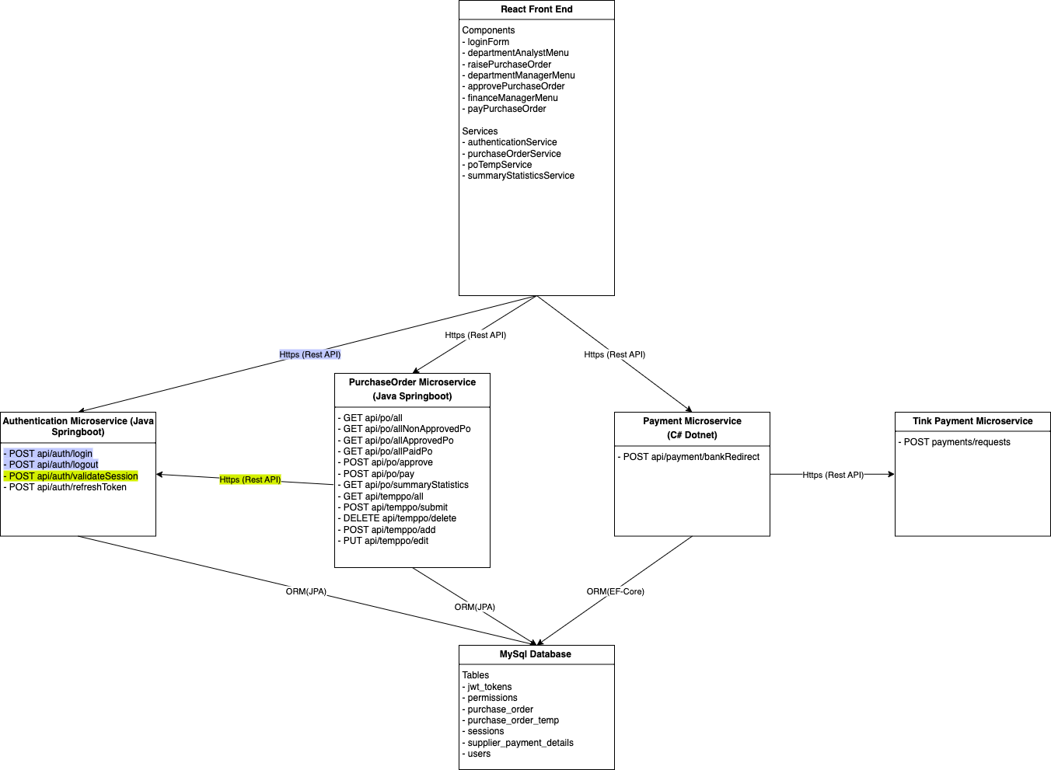
Web Application Component Diagram

Slide 15
REST API Stakeholder Interaction diagram

Slide 16
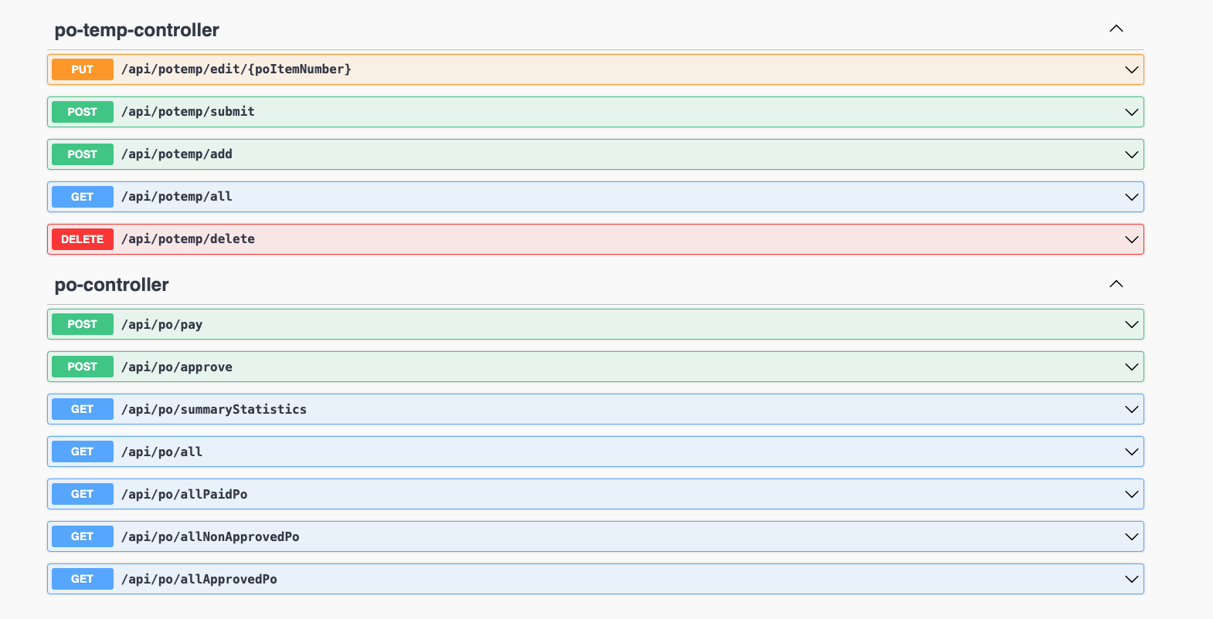
Swagger API Specification Purchase Orders & Payment

Slide 17
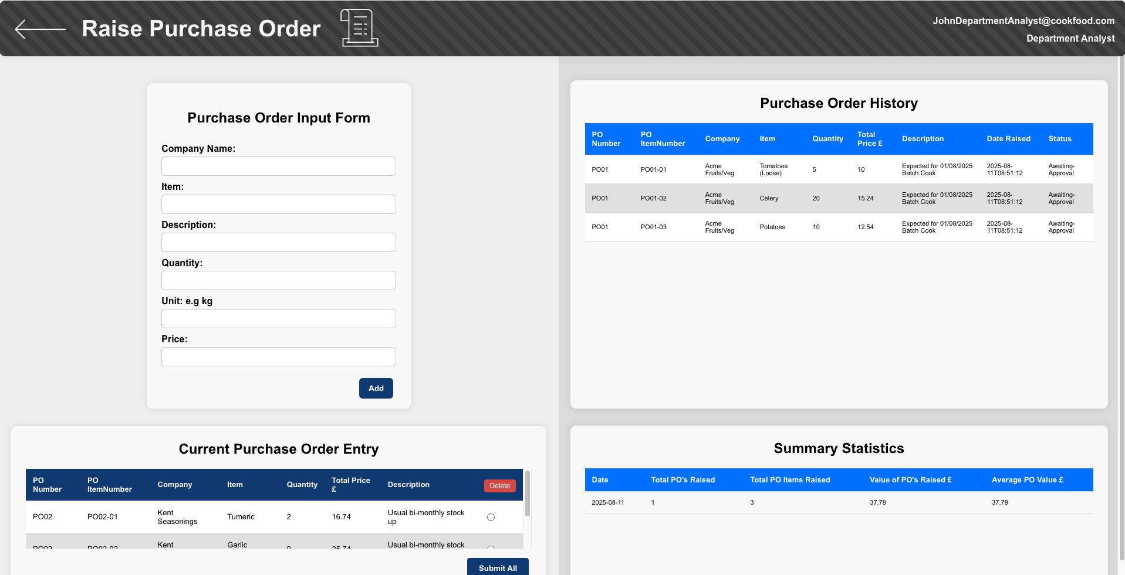
Department Analyst

Slide 18
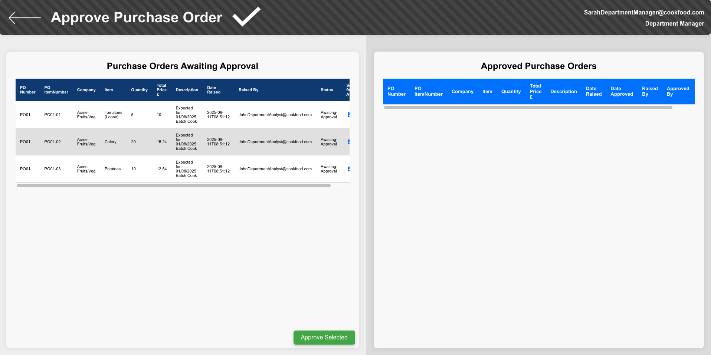
Department Manager

Slide 19
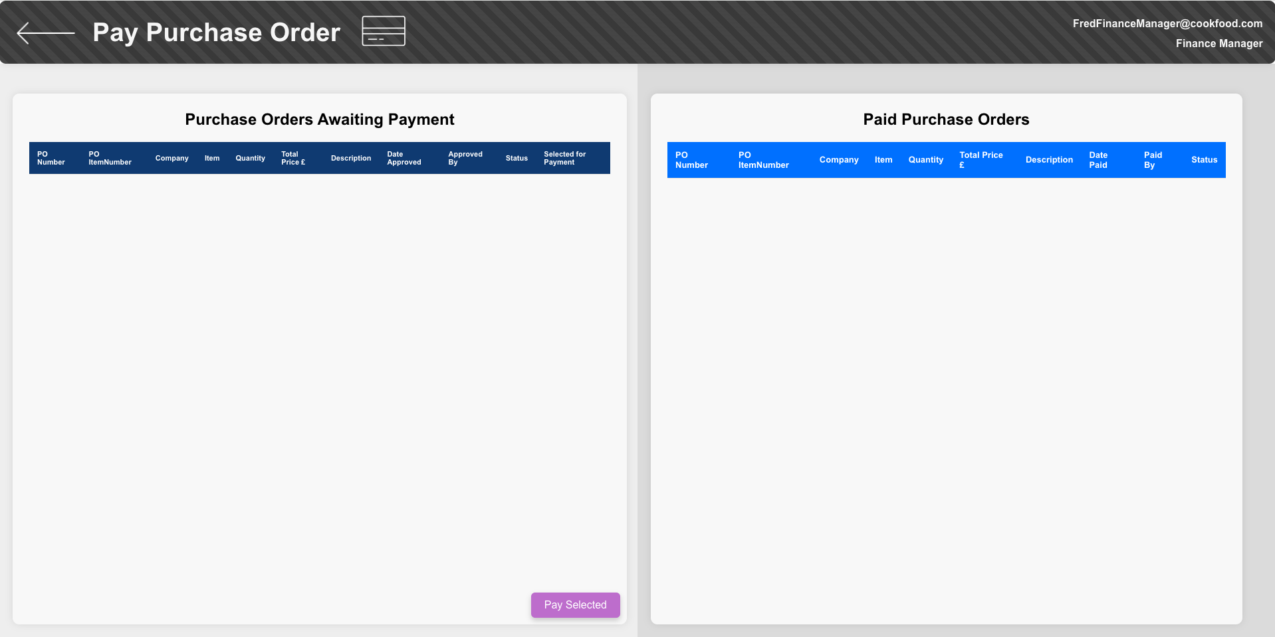
Finance Manager

Slide 20
REST API Sequence Diagram (Low level diagrams)

Slide 21
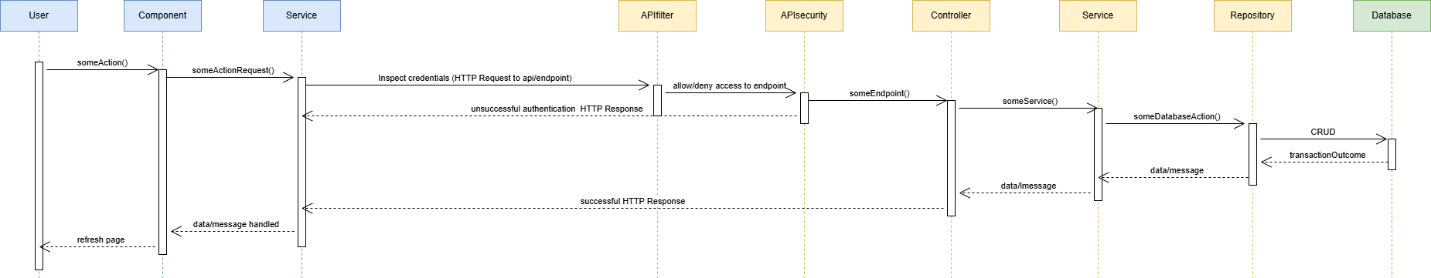
API Sequence Diagram – Basic Sequence
There are 13 purchase order and payment endpoints
Requests to these endpoints will follow a similar pattern
Front end
Back end
Database

Slide 22
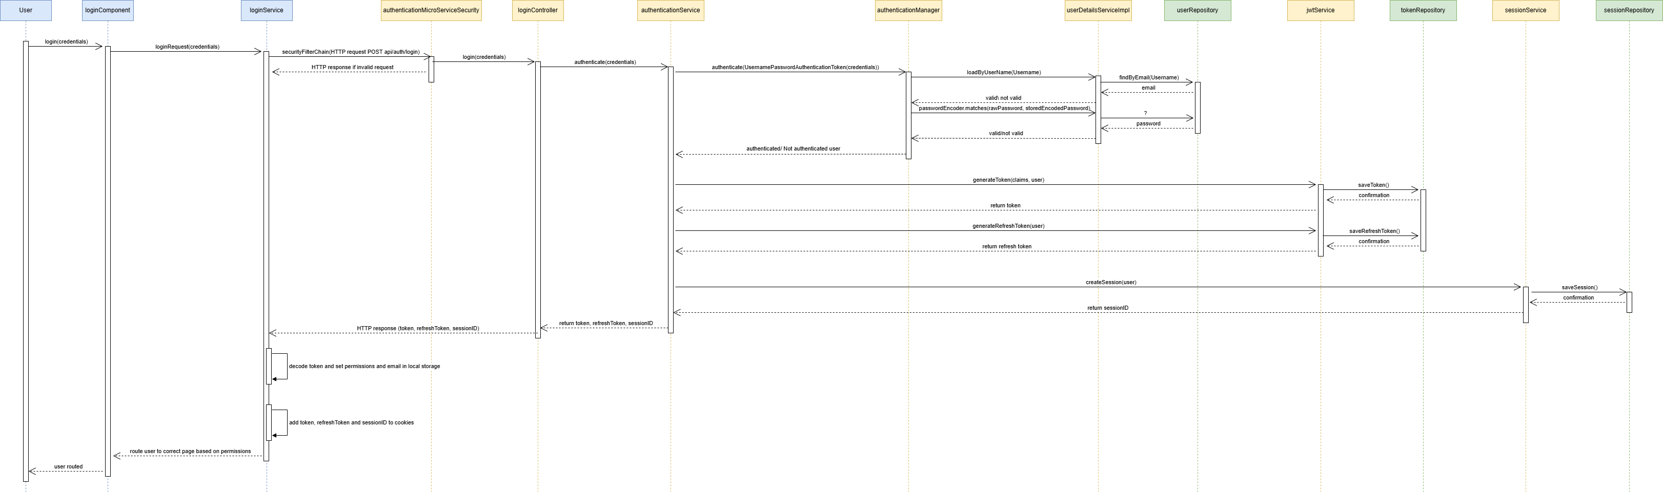
API Sequence Diagram – Authentication Request
Front end
Back end
Database

Slide 23
Database Design (Low level diagrams)

Slide 24
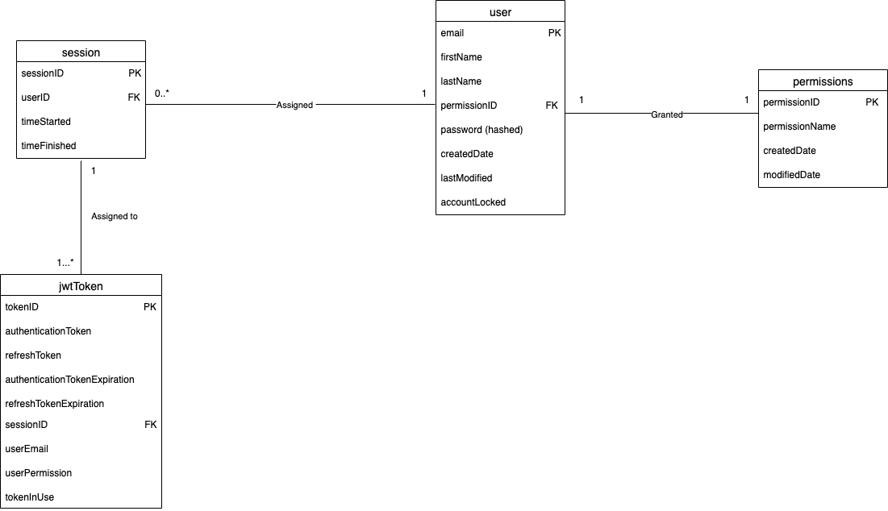
Relational/Conceptual Model – Authentication

Slide 25
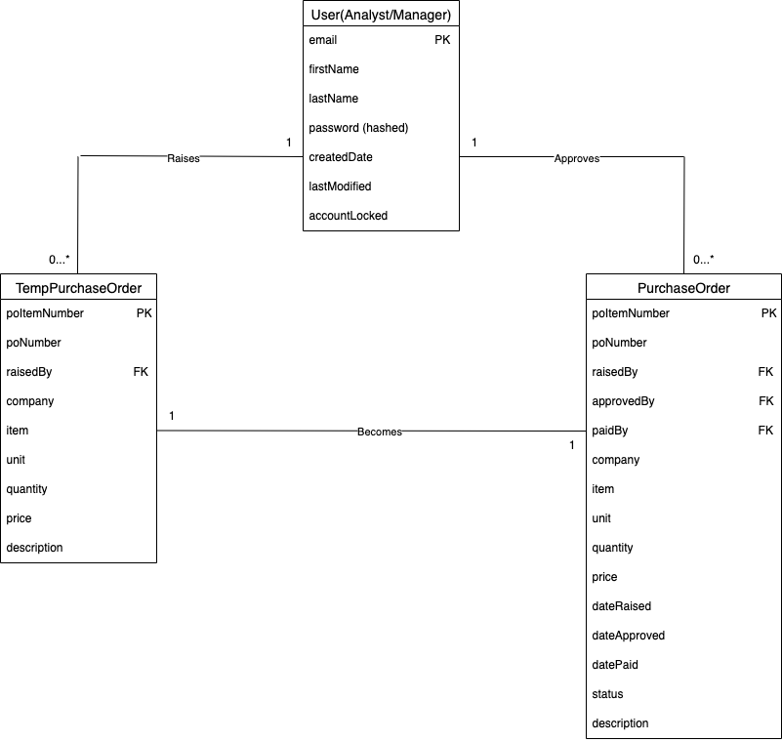
Relational/Conceptual Model– Purchase Order Item

Slide 26
Acceptance Testing

Slide 27
Acceptance Test | Status
As a department analyst, I’d like to be able to log in and view the correct menu so I can raise my purchase order. | Pass
As a department manager, I’d like to be able to log in and view the correct menu so I can approve purchase order. | Pass
As a finance manager, I’d like to be able to log in and view the correct menu so I can pay for the purchase order. | Pass
As a stakeholder, from the menu, I’d like a logout button so I can logout. | Pass
As a stakeholder, I’d like to see my email and role on the top right of the screen so I can confirm my privileges. | Pass
As a department analyst, I’d like to be able to click the raise ‘purchase order button’ so I can be taken to the raise purchase order screen. | Pass
As a department analyst, I’d like to be able to input information about a purchase order item so I can then add it to the current purchase order entry. | Pass
As a department analyst, I’d like to be able to add a purchase order item to the current purchase order entry (temporary purchase order table) so I can logically group purchase order items under one purchase order. | Pass
As a department analyst, I’d like to be able to edit select fields (company, item, quantity, total price and description) in the current purchase order entry and edit them so I can correct information about the current purchase if required. | Pass

Slide 28
Acceptance Test | Status
As a department analyst, I’d like to be able to delete a current purchase order item and for the remaining purchase order items to be reindexed so I can change the current entry list if required. | Pass
As a department analyst, I’d like to be able to view a purchase order history table so I can keep track of the purchase orders and purchase order items I have raised. | Pass
As a department analyst, I’d like to be able to view summary statistics so that, at a glance, I can glean basic information about my purchase order history. | Pass
As a department manager, I’d like to be able to click on the approve purchase order button on the menu and then to be taken to the approve purchase order screen. | Pass
As a department manager, I’d like to be able to view purchase order items awaiting approval so I can verify that the correct purchase orders have been raised. | Pass
As a department manager, I’d like to be able to view approved purchase order items so I can view the purchase orders raised. | Pass
As a department manager, I’d like to be able to select several purchase order items to approve at a time. | Pass
As a stakeholder, I’d like to be able to click the back arrow and return to the menu so I can navigate away from the page. | Pass
As a stakeholder, I’d like to be able to view my credentials on the top right of the screen. | Pass

Slide 29
Acceptance Test | Status
As a finance manager, I’d like to be able to view the purchase order items awaiting payment so I can see which purchase orders need to be paid. | Pass
As a finance manager, I’d like to be able to select multiple purchase order items so that I can prepare them for payment. | Pass
As a finance manager, I’d like to be able to press the ‘Pay selected’ button and to be taken to the Tink payment portal, so I can then play for the selected purchase order items. | Pass
As a finance manager, I’d like to be able to view the paid purchase order items in the paid purchase orders table. | Pass

